Slide 1

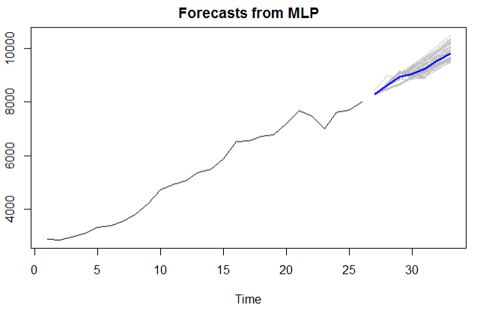

california
Forecast of New Positive Cases (Avg of last 7 Days) - For Use in Multivariate forecasts of Currently Hospitalized Patients
Notes:
Josh Notes: 13 sec
The plot above shows the forecast of New Cases that was used in all of the compared multivariate models as a consistent baseline to predict the next seven days of hospitalizations. An mlp was used to calculate these estimates by taking the average of 50 generated models.

